Slide 1
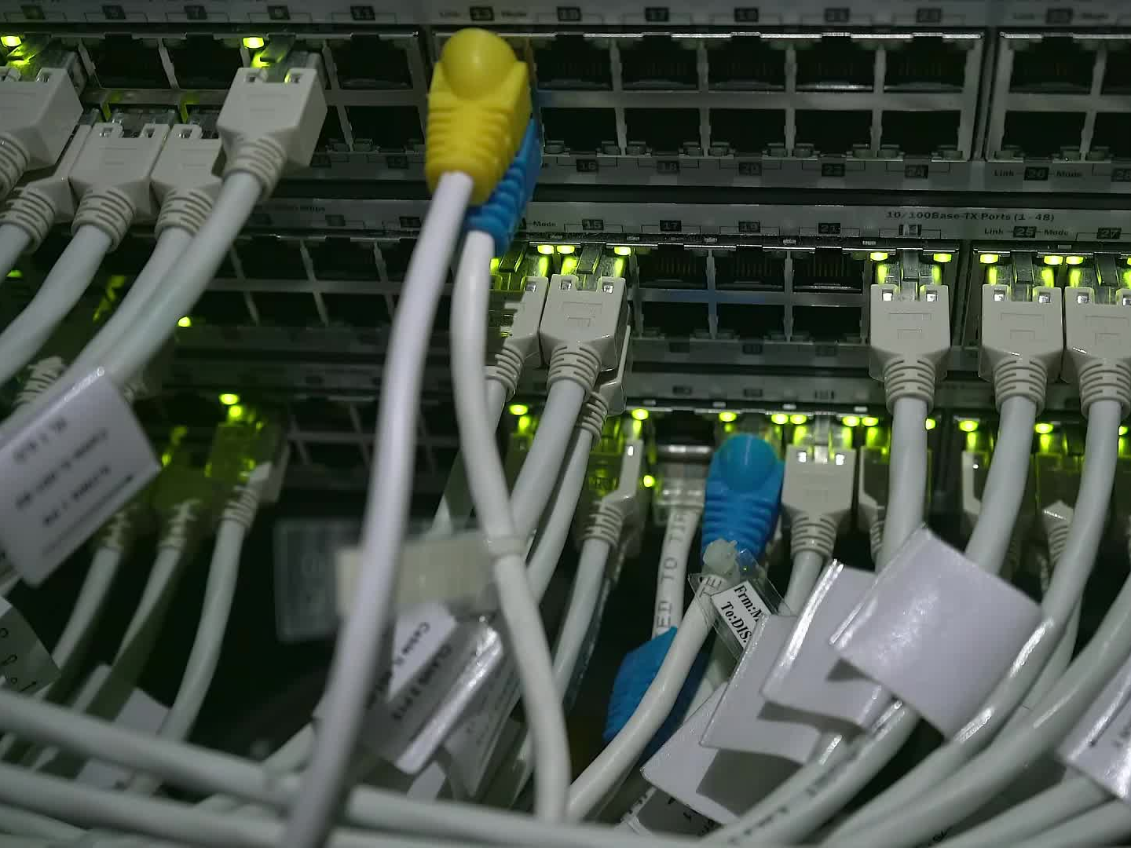
CIFAR-10 Image Classification Using CNN and Distributed Computing
Team Members: Varshitha Reddy Davarapalli, Saketha Kusu, Karunakar Uppalapati

Slide 2

Problem Statement and Goals
Goal:
Classify CIFAR-10 images into 10 classes using CNN.
Leverage distributed computing via Spark for efficient model training.
Challenges:
Managing large datasets.
Improving generalization and preventing overfitting.
Optimizing CNN for distributed environments.

Slide 3
Dataset Details
Dataset: CIFAR-10
Total: 60,000 images across 10 classes (e.g., airplane, automobile).
Image size: 32x32 pixels, 3 color channels (RGB).
Train/Test Split:
Training set: 50,000 images.
Testing set: 10,000 images.
Preprocessing Techniques:
Normalization: Pixel values are scaled to the range [0, 1] to enhance model convergence.
One-Hot Encoding: Class labels are converted to vectors for compatibility with the softmax output layer of the CNN.
.

Slide 4
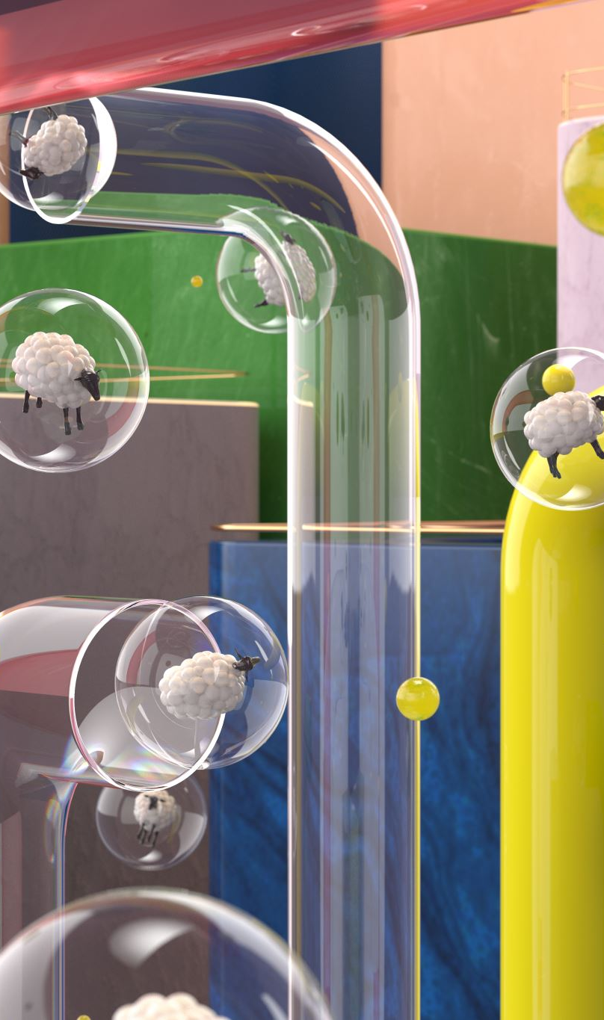
CNN Architecture
The proposed CNN model consists of:
Convolutional Layers:
Extract spatial features from images.
Layer 1: 32 filters, 3x3 kernel, ReLU activation, Max pooling.
Layer 2: 64 filters, 3x3 kernel, ReLU activation, Max pooling.
Layer 3: 128 filters, 3x3 kernel, ReLU activation, Max pooling.
Flattening Layer:
Converts the final convolutional output into a 1D array for fully connected layers.
Fully Connected Layers:
Dense Layer: 128 units with ReLU activation, followed by dropout (rate: 0.5) to prevent overfitting.
Output Layer: 10 units with softmax activation for multi-class classification.

Slide 5
Distributed Computing with Spark
To address the computational limitations, Apache Spark was configured across multiple virtual machines:
Configuration:
Executor memory: 2 GB.
Cores per executor: 2.
Data Distribution:
CIFAR-10 images were distributed across executors for parallel processing, accelerating batch processing and reducing training time.
Integration:
Python and Spark interoperability was optimized for seamless model training across VMs.

Slide 6
Implementation and Training
Preprocessing:
Data normalized and split into training (80%) and testing (20%) sets.
Training Setup:
Hyperparameters:
Learning rate: 0.001.
Batch size: 64.
Epochs: 30.
Spark handled distributed computations for faster convergence.
Validation:
Validation loss was monitored, and early stopping was implemented to optimize training.

Slide 7
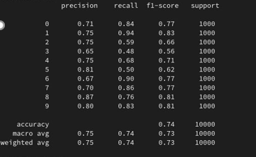
Evaluation Metrics and Results
Accuracy:
Overall accuracy achieved: 73.9% on the test dataset.
Precision, Recall, and F1-Score:
Class-wise metrics were calculated to evaluate the model’s performance.
Confusion Matrix:
Detailed insights into misclassifications and class-wise performance.
Visualization:
Training/Validation accuracy and loss were plotted to monitor convergence and overfitting.

Slide 8
Results
Training Results:
The model demonstrated steady improvement in accuracy across epochs.
Loss curves indicated good convergence, with validation loss closely tracking training loss.
Test Accuracy:
Achieved 73.9%, indicating the effectiveness of the CNN model and the distributed training framework.
Performance Analysis:
The confusion matrix revealed areas for improvement, particularly in closely resembling classes.

Slide 9
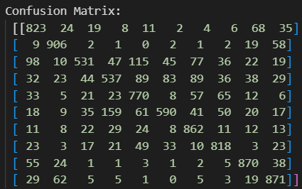
Confusion Matrix for Model Performance
The confusion matrix shows the classification results of the CNN on the CIFAR-10 test dataset. Diagonal values represent correct predictions, while off-diagonal values indicate misclassifications. It highlights the model's strengths in specific categories and areas where improvement is needed.

Slide 10
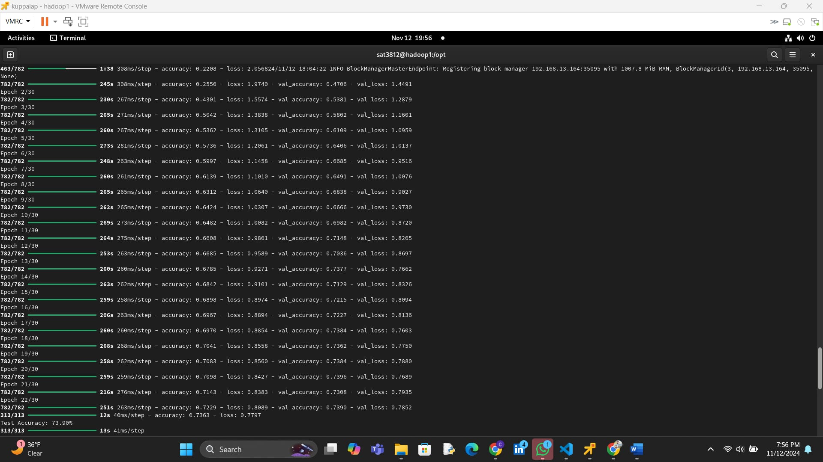

Slide 11
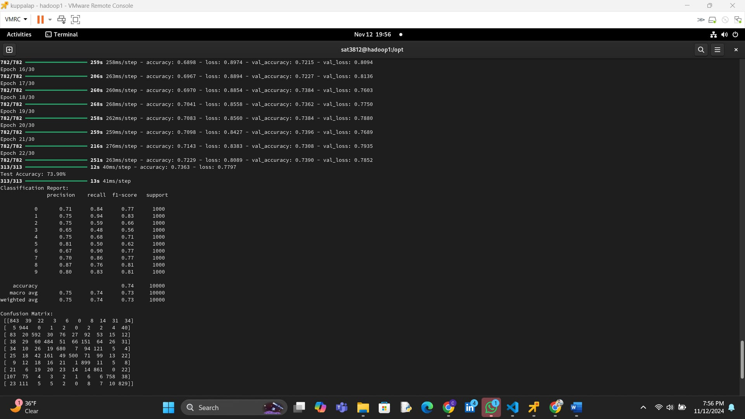

Slide 12
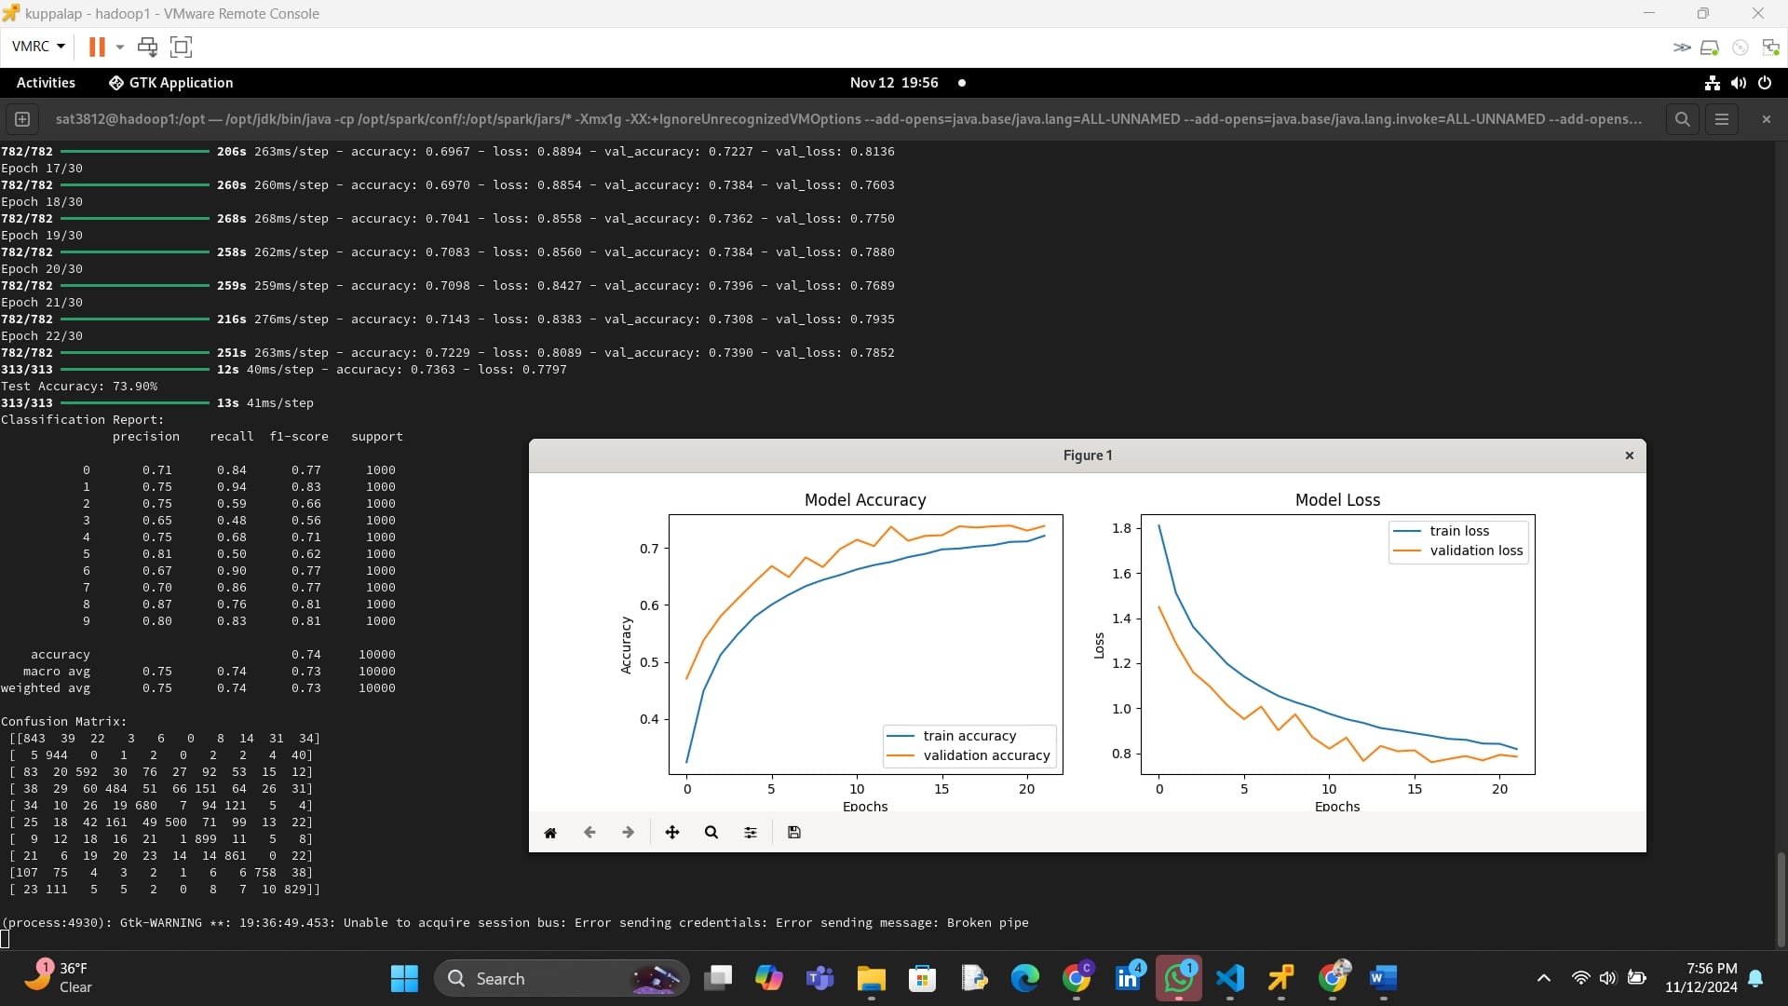

Slide 13
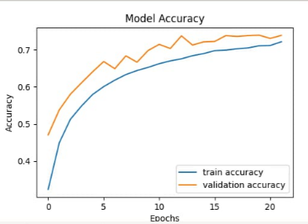
Model Accuracy Graph:
The graph shows the training accuracy (blue) and validation accuracy (orange) across 20 epochs.
Key Observations:
Both accuracies increase steadily, indicating the model learns effectively over time.
Validation accuracy is consistently higher than training accuracy, suggesting good generalization without overfitting.
The model achieves approximately 70–75% accuracy on unseen validation data, highlighting its reliability.

Slide 14
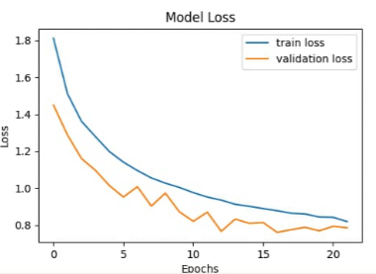
Model Loss Graph:
The graph illustrates training loss (blue) and validation loss (orange) over 20 epochs.
Key Observations:
Both losses decrease consistently, showing the model is improving during training.
Validation loss remains lower than training loss, indicating the model is not overfitting and performs well on unseen data.
Loss convergence around later epochs suggests the model has reached an optimal state with minimal overfitting.

Slide 15

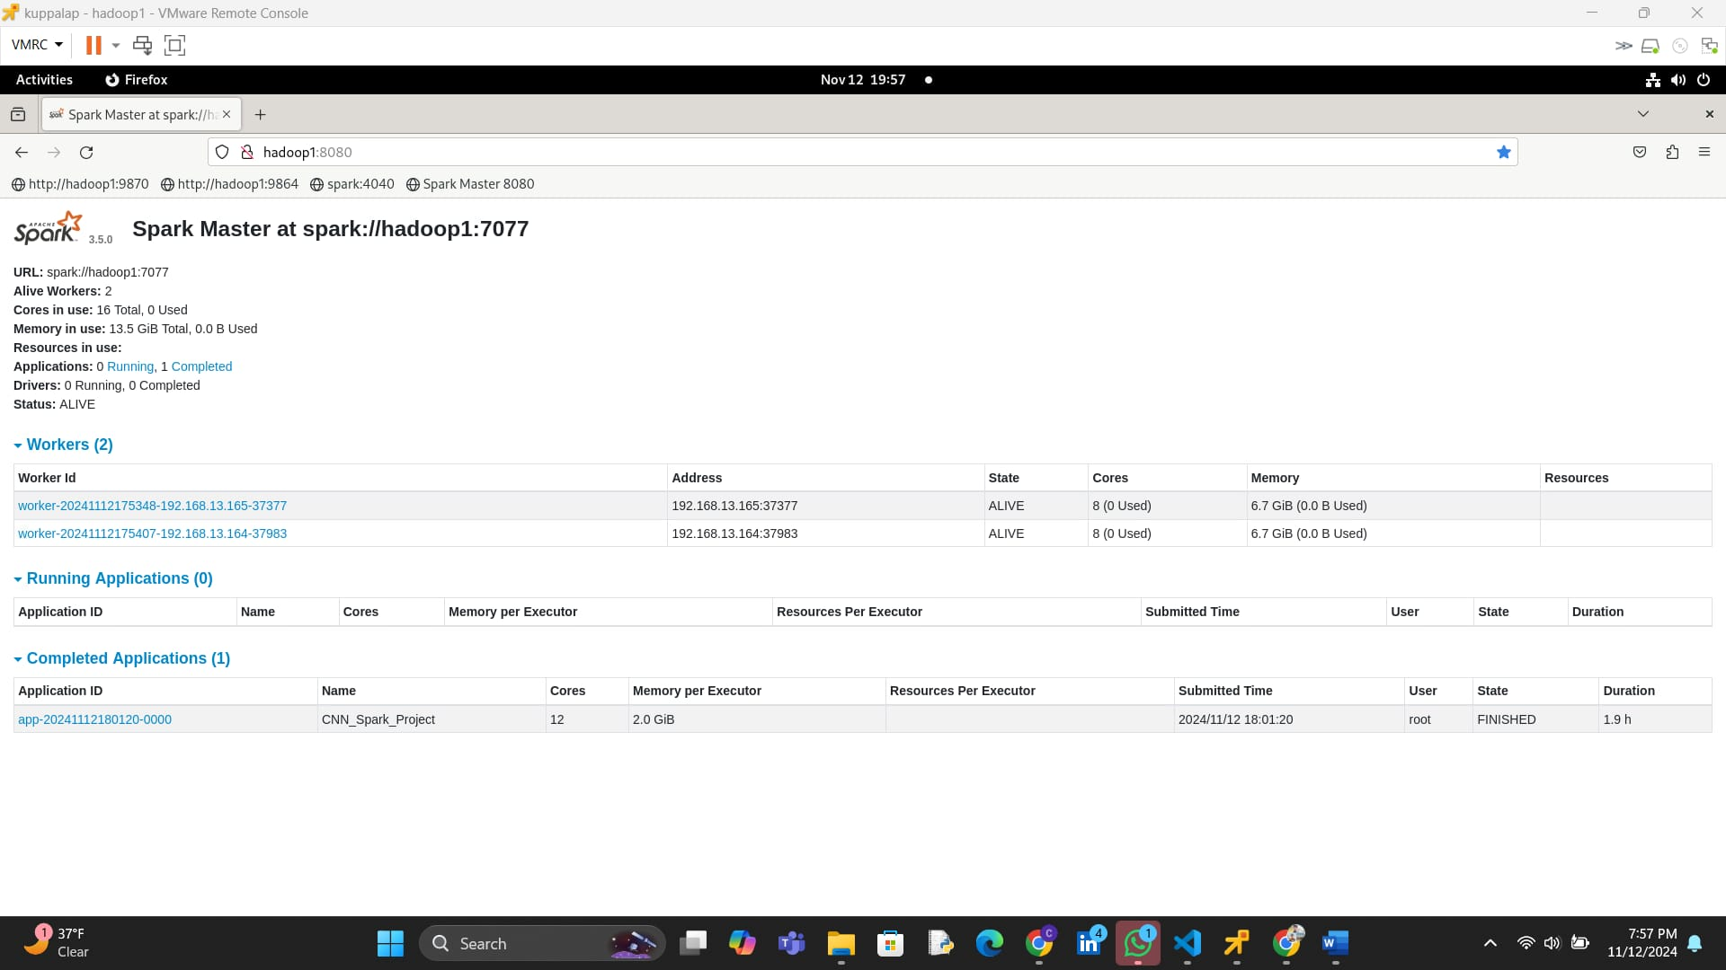
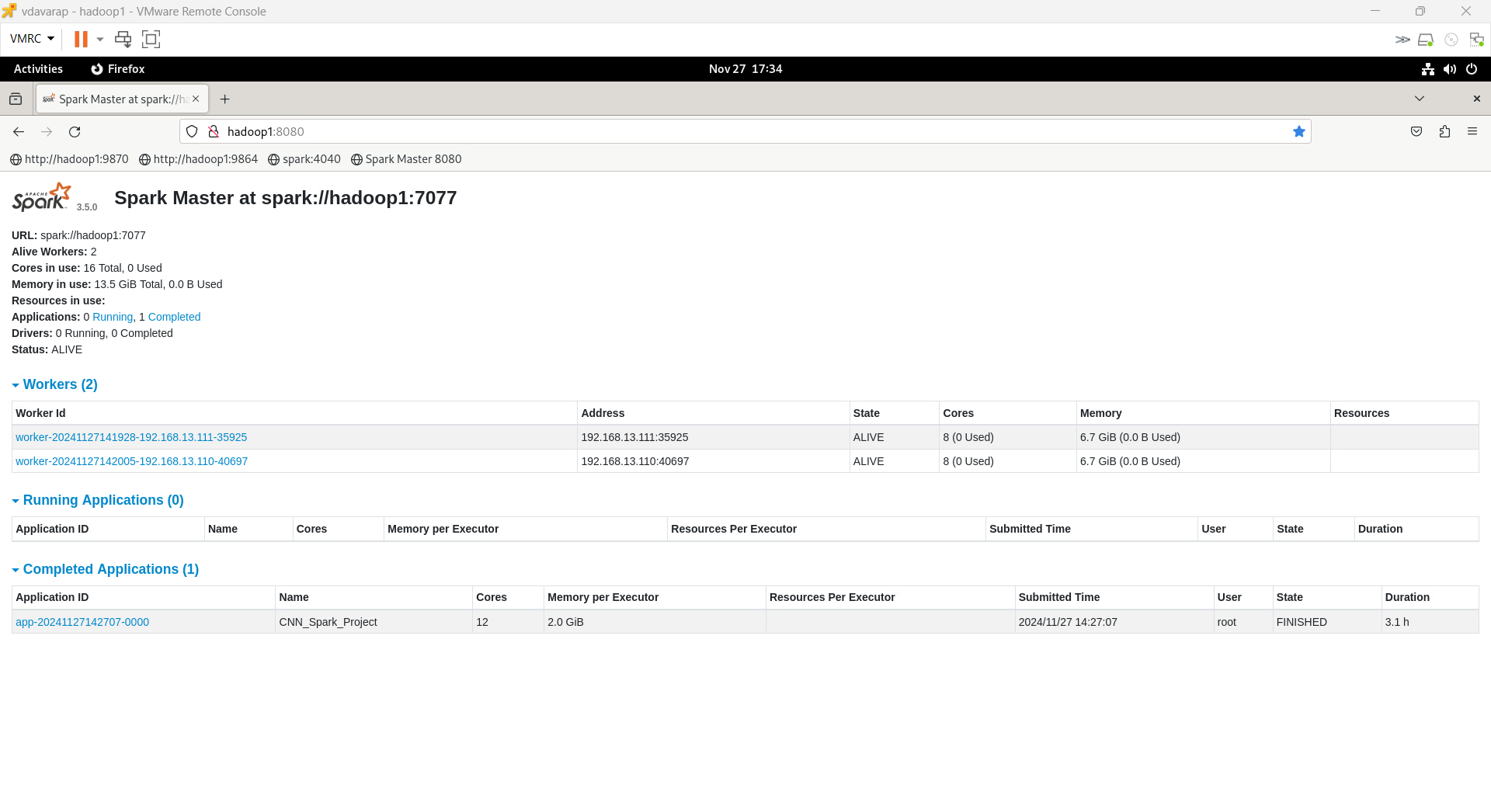
Spark performance

Slide 16
Conclusion and Future Work
Conclusions:
Successfully implemented a scalable framework for image classification using CNN and Apache Spark.
Demonstrated the viability of distributed computing for deep learning.
Future Directions:
Transfer Learning:
Use pre-trained models (e.g., ResNet, VGG) to enhance accuracy and reduce training time.
Model Explainability:
Implement visualization tools like Grad-CAM to interpret the model’s decisions.
Hyperparameter Tuning:
Use advanced techniques like Bayesian optimization for fine-tuning parameters.

Slide 17
Thank u

